Slide 1
Introduction to NLP and topic modeling
Zhenya Antić
November 2021
ODSC WEST Conference

Slide 2
Intro about me
Zhenya Antić
zhenya@practicallinguistics.com
https://www.linkedin.com/in/zhenya-antic/
NLP Consultant, Practical Linguistics Inc.

Slide 3
Overview of the workshop
Theoretical part:
Structure of NLP project
Approaches to NLP (and topic modeling)
Practical part:
Data
Preprocessing
Vectorizing
NLP architecture
Visualization
Evaluation
Gift part
Drawing of winners to receive Python NLP Cookbook

Slide 4
Structure of NLP project
Goal of project
Data
Exploratory data analysis
Choosing an approach
Vectorizing the data
Building the NLP architecture
Visualization
Evaluation

Slide 5
Goal of NLP project
Usually we want to automate a task that is time consuming or laborious
Examples:
Analysis of a business’s social media by topic and sentiment to rate customer satisfaction
Filtering incoming emails to the right department
Filtering news from a stream that are about a particular company
Creating a chatbot
Recommendation engine
Document summarization

Slide 6
Goal of NLP project
According to the general goal, we can choose techniques:
Analysis of a business’s social media by topic and sentiment to rate customer satisfaction → topic modeling and sentiment analysis
Filtering incoming emails to the right department → document classification
Filtering news from a stream that are about a particular company → named entity recognition (NER)
Creating a chatbot → NER, intent classification, natural language generation (NLG)
Recommendation engine → topic modeling, similarity measurements
Document summarization → NER, topic modeling

Slide 7
Today’s project
Goal of today’s project: given a set of news articles, sort them into categories that align with topics they talk about

Slide 8
Approaches to NLP
Rule-based approaches
E.g., if a news article contains the word football, it’s about sport.
Supervised approaches
We have the data and the right answers for the data
Train a model that will compute the approximation of the function that gives the right answers (never 100% correct, but can get close)
Statistical machine learning: SVM, Naïve Bayes, regression, etc.
Deep learning: LSTM, RNN, CNN, transformers

Slide 9
Approaches to NLP
Unsupervised
E.g., grouping similar data into unnamed clusters
Semi-supervised
E.g., seeding the model with the labeled examples and using the output of the trained model as input to the next training iteration
Self-supervised
Neural networks cannot be unsupervised
Can create “the right answer” from the data
E.g., predicting a blacked out word from the text

Slide 10
Approaches to topic modeling
Rule-based:
Certain keywords belong to certain topics
Analyze the data to see which keywords are common to certain topics and not others
Only works if you know the topics in advance
Supervised:
You have to know the topics in advance
Use any ML method

Slide 11
Approaches to topic modeling
Unsupervised
Clustering: grouping similar items together
LDA: generative statistics method for creating topic clusters, calculates co-occurrence probabilities
NMF: use matrix factorization to uncover topics
We will use LDA

Slide 12
Data
Labeled data
Text and the “right answer”. E.g., a news article (data) and its category (“right answer”)
Unlabeled data
Just text. E.g., a large collection of news articles
Proprietary data or domain experts ready to label
Public data
Dataset repositories, such as Kaggle
Scraping the Internet (need to be careful with legalities)
No data

Slide 13
Today’s data
The BBC news dataset:
http://mlg.ucd.ie/datasets/bbc.html
Also in the Python NLP Cookbook repository: https://github.com/PacktPublishing/Python-Natural-Language-Processing-Cookbook/blob/master/Chapter04/bbc-text.csv
Technically, the dataset contains the correct answers
5 topics
Politics
Business
Sport
Tech
Entertainment
We will just use the text

Slide 14
Today’s data
tv future in the hands of viewers with home theatre systems plasma high-definition tvs and digital video recorders moving into the living room the way people watch tv will be radically different in five years time. that is according to an expert panel which gathered at the annual consumer electronics show in las vegas to discuss how these new technologies will impact one of our favourite pastimes. with the us leading the trend programmes and other content will be delivered to viewers via home networks through cable satellite telecoms companies and broadband service providers to front rooms and portable devices. one of the most talked-about technologies of ces has been digital and personal video recorders (dvr and pvr). these set-top boxes like the us s tivo and the uk s sky+ system allow people to record store play pause and forward wind tv programmes when they want. essentially the technology allows for much more personalised tv. they are also being built-in to high-definition tv sets which are big business in japan and the us but slower to take off in europe because of the lack of high-definition programming…
Category: tech

Slide 15
Today’s data
worldcom boss left books alone former worldcom boss bernie ebbers who is accused of overseeing an $11bn (£5.8bn) fraud never made accounting decisions a witness has told jurors. david myers made the comments under questioning by defence lawyers who have been arguing that mr ebbers was not responsible for worldcom s problems. the phone company collapsed in 2002 and prosecutors claim that losses were hidden to protect the firm s shares. mr myers has already pleaded guilty to fraud and is assisting prosecutors. on monday defence lawyer reid weingarten tried to distance his client from the allegations…
Category: business

Slide 16
Exploratory Data Analysis
Before doing the project, it’s good to take an in-depth look at the data
Things to look for in NLP EDA:
Word and n-gram frequency
Word and sentence length per news article
When you have classes, look at those per class
We need to do some preprocessing

Slide 17
EDA and Preprocessing
Jupyter notebook (https://github.com/zhenya-pl/odsc_west)

Slide 18
Vectorizing data
Computers can’t read words or sentences
They can read numbers
Need to represent text as numbers

Slide 19
Vectorizing data: bag-of-words
Bag-of-words: really “bag-of-numbers”
Start with all the words in the dataset
Each word becomes an index; each document is a vector of the same size
Replace each word with its count in that document

Slide 20
Vectorizing data: bag-of-words
For example, imagine we have 3 documents:
1: “I love cats”
2: “Steve loves dogs”
3: “Cats and dogs love food”
Our vocabulary is: [“I”, “love”, “cats”, “Steve”, “loves”, “dogs”, “and”, “food”]
1: [1, 1, 1, 0, 0, 0, 0, 0]
2: [0, 0, 0, 1, 1, 1, 0, 0]
3: [0, 1, 1, 0, 0, 1, 1, 1]
4: “I love cats, and Steve loves cats”
4: [1, 1, 2, 1, 1, 0, 1, 0]

Slide 21
Vectorizing data: TF-IDF
Better bag-of-words
Each count is divided by the number of times the word appears in all documents
So very high frequency words don’t high scores any more
And words that are characteristic to certain documents have higher scores

Slide 22
Vectorizing data: TF-IDF
1: “I love cats”
2: “Steve loves dogs”
3: “Cats and dogs love food”
4: “I love cats, and Steve loves cats”
Lemmatize loves to love
Our vocabulary is: [“I”, “love”, “cats”, “Steve”, “dogs”, “and”, “food”]
Inverse document frequency: [log(4/2), log(4/4), log(4/3), log(4/2), log(4/2), log(4/2), log(4/1)]
Inverse document frequency: [1, 0, 0.4, 1, 1, 1, 2]
1: [1*1, 1*0, 1*0.4, 0*1, 0*1, 0*1, 0*2] = [1, 0, 0.4, 0, 0, 0, 0]
2: [0*1, 1*0, 0*0.4, 1*1, 1*1, 0*1, 0*2] = [0, 0, 0, 1, 1, 0, 0]
3: [0*1, 1*0, 1*0.4, 0*1, 1*1, 1*1, 1*2] = [0, 0, 0.4, 0, 1, 1, 2]
4: [1*1, 1*0, 1*0.4, 1*1, 0*1, 1*1, 0*2] = [1, 0, 0.4, 1, 0, 1, 0]

Slide 23
Vectorizing data: bag-of-words
Advantages:
Easy to compute
Works well in many instances
Disadvantages:
Size of vector == size of vocabulary → large and sparse matrices

Slide 24
N-grams work the same way
1: “I love cats”
2: “Steve loves dogs”
3: “Cats and dogs love food”
Our vocabulary is: [“I”, “love”, “cats”, “Steve”, “loves”, “dogs”, “and”, “food”]
1: [1, 1, 1, 0, 0, 0, 0, 0]
Add bigrams, vocabulary becomes: […, “I love”, “love cats”, “Steve loves”, “loves dogs”, “cats and”, “and dogs”, “dogs love”, “love food”]

Slide 25
Vectorizing data: word2vec
Word2vec is a framework for encoding every word as an n dimensional vector, where n is usually 200 or 300
No large and sparse matrices
The vectors are a by-product of a self-supervised deep learning algorithm (neural network) that predicts a word given its surrounding words
Resulting vectors save at least some of the semantics
Some reasoning can be performed using geometry
Comparing words using cosine similarity over their vectors gives comparably good results (cosine similarity as a measure of meaning similarity)

Slide 26
Vectorizing data
We will use TF-IDF on lemmatized unigrams and bigrams
You can try it with trigrams added later
Jupyter notebook (https://github.com/zhenya-pl/odsc_west)

Slide 27
Topic modeling: LDA
Latent Dirichlet Allocation
The most famous algorithm for topic modeling
Maximize distance between clusters of documents (topics) based on probabilities
The algorithm generates sets of “documents” and compares to the input
Picks the model that generated the most probable set
Great explanation here: https://www.youtube.com/watch?v=T05t-SqKArY

Slide 28
Topic modeling: K-means clustering
Each document is a vector
Given a number of topics, k, create k cluster centroids
Cluster documents to each centroid based on geometric distance between vectors
Update centroids
Repeat several hundred times (a parameter you set)
Can be applied to any unsupervised classification project

Slide 29
Topic modeling: NMF
NMF: non-negative matrix factorization
The method decomposes the input matrix into two smaller matrices
Topics (words)
Weight for the topics

Slide 30
Topic modeling: practical part
We will use LDA
Jupyter notebook (https://github.com/zhenya-pl/odsc_west)

Slide 31
Evaluation
Topic model evaluation:
Unsupervised learning: hard to evaluate
Create a small labeled set and evaluate using that

Slide 32
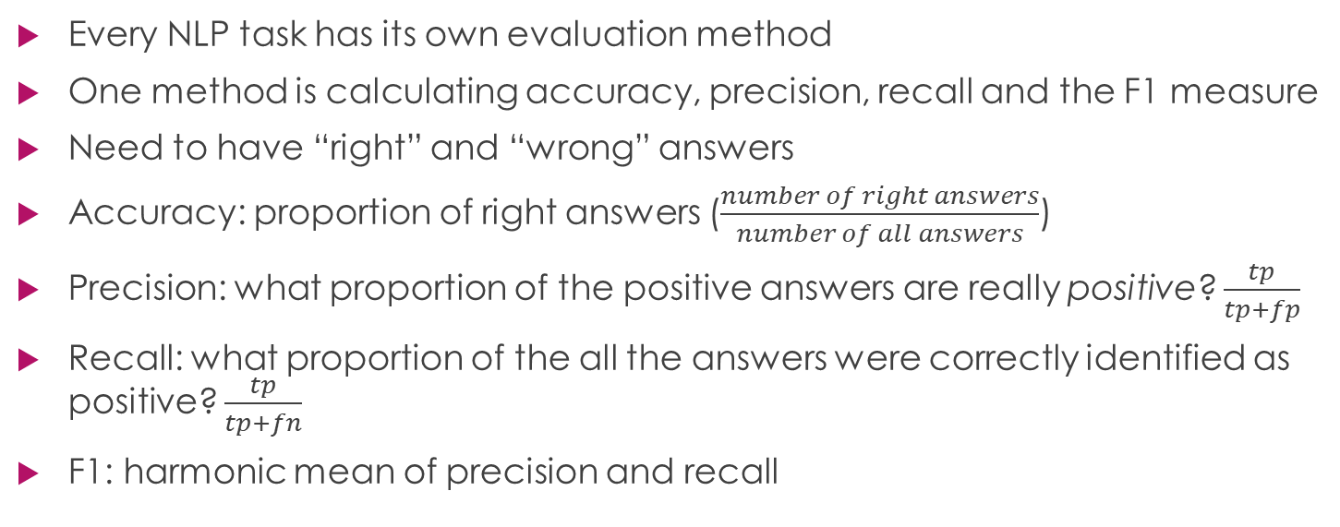
Evaluation
Every NLP task has its own evaluation method
One method is calculating accuracy, precision, recall and the F1 measure
Need to have “right” and “wrong” answers
Accuracy: proportion of right answers ($\frac{number of right answers}{number of all answers}$)
Precision: what proportion of the positive answers are really positive? $\frac{tp}{tp+fp}$
Recall: what proportion of the all the answers were correctly identified as positive? $\frac{tp}{tp+fn}$
F1: harmonic mean of precision and recall

Slide 33
Evaluation
Usually, both precision and recall can’t be optimized for at the same time
Tradeoff: either precision or recall
Depends on use case:
Fraud detection, cancer detection: high recall, false positives weeded out by people
Spam detection: high precision, important emails shouldn’t end up in spam

Slide 34
Evaluation
What kind of data do you use for evaluation?
Training, validation, test sets
E.g., split 70% training, 15% each for validation and test
Training: used to create the model
Validation: set you use to tune the model
Usually hyperparameters, such as the learning rate
Test: final evaluation when the model is ready on unseen data
Topic modeling: can use a test set to evaluate (needs to be labeled)

Slide 35
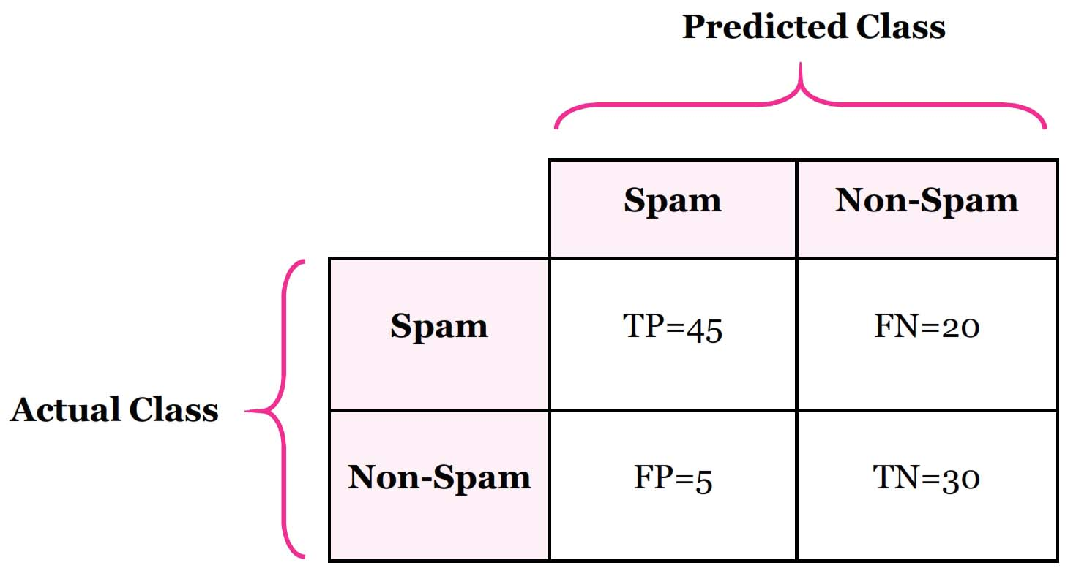
Confusion matrix
Shows which classes are confused with which

Slide 36
Evaluation
Jupyter notebook (https://github.com/zhenya-pl/odsc_west)

Slide 37
Book prizes
Please enter your email into the chat if you’d like a chance to win my book, Python NLP Cookbook

Slide 38
Topic modeling with knowledge graphs
Knowledge graphs are a knowledge representation tool
A set of entities
Entities could have properties
A set of relations
Each relation connects two entities

Slide 39
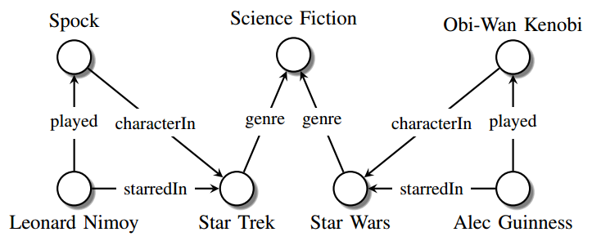
Topic modeling with knowledge graphs

Slide 40
Topic modeling with knowledge graphs
How to input the information into the algorithm?
Knowledge graph embeddings
Similar to word embeddings
Several different algorithms to generate the embeddings
Represent entities and relations as vectors in the same vector space

Slide 41
Topic modeling with knowledge graphs
The embeddings are used in the LDA model to generate more coherent topics

